Slide 1
Chapter 17
Advanced Uses of Pointers

Slide 2
Dynamic Storage Allocation
C’s data structures, including arrays, are normally fixed in size.
Fixed-size data structures can be a problem, since we’re forced to choose their sizes when writing a program.
Fortunately, C supports dynamic storage allocation: the ability to allocate storage during program execution.
Using dynamic storage allocation, we can design data structures that grow (and shrink) as needed.

Slide 3
Dynamic Storage Allocation
Dynamic storage allocation is used most often for strings, arrays, and structures.
Dynamically allocated structures can be linked together to form lists, trees, and other data structures.
Dynamic storage allocation is done by calling a memory allocation function.

Slide 4
Memory Allocation Functions
The <stdlib.h> header declares three memory allocation functions:
malloc—Allocates a block of memory but doesn’t initialize it.
calloc—Allocates a block of memory and clears it.
realloc—Resizes a previously allocated block of memory.
These functions return a value of type void * (a “generic” pointer).

Slide 5
Null Pointers
If a memory allocation function can’t locate a memory block of the requested size, it returns a null pointer.
A null pointer is a special value that can be distinguished from all valid pointers.
After we’ve stored the function’s return value in a pointer variable, we must test to see if it’s a null pointer.

Slide 6
NULL Pointers
An example of testing malloc’s return value:
p = malloc(10000);
if (p == NULL) {
/* allocation failed; take appropriate action */
}
NULL is a macro (defined in various library headers) that represents the null pointer.
Some programmers combine the call of malloc with the NULL test:
if ((p = malloc(10000)) == NULL) {
/* allocation failed; take appropriate action */
}

Slide 7
NULL Pointers
Pointers test true or false in the same way as numbers.
All non-null pointers test true; only null pointers are false.
Instead of writing
if (p == NULL) …
we could write
if (!p) …
Instead of writing
if (p != NULL) …
we could write
if (p) …

Slide 8
Dynamically Allocated Strings
Dynamic storage allocation is often useful for working with strings.
Strings are stored in character arrays, and it can be hard to anticipate how long these arrays need to be.
By allocating strings dynamically, we can postpone the decision until the program is running.

Slide 9
Using malloc to Allocate Memory for a String
Prototype for the malloc function:
void *malloc(size_t size);
malloc allocates a block of size bytes and returns a pointer to it.
size_t is an unsigned integer type defined in the library.

Slide 10
Using malloc to Allocate Memory for a String
A call of malloc that allocates memory for a string of n characters:
p = malloc(n + 1);
p is a char * variable.
Each character requires one byte of memory; adding 1 to n leaves room for the null character.
Some programmers prefer to cast malloc’s return value, although the cast is not required:
Char *p;
p = (char *) malloc(n + 1);

Slide 11
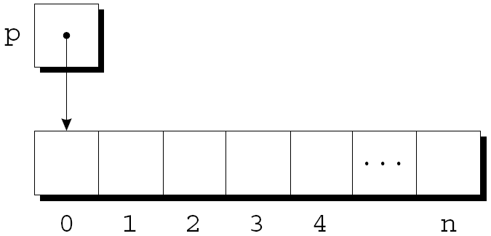
Using malloc to Allocate Memory for a String
Memory allocated using malloc isn’t cleared, so p will point to an uninitialized array of n + 1 characters:

Slide 12
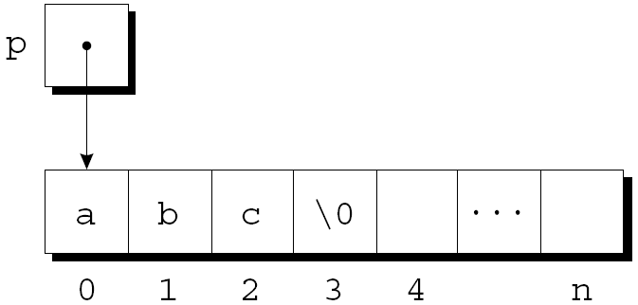
Using malloc to Allocate Memory for a String
Calling strcpy is one way to initialize this array:
strcpy(p, "abc");
The first four characters in the array will now be a, b, c, and \0:

Slide 13
Using Dynamic Storage Allocation in String Functions
Dynamic storage allocation makes it possible to write functions that return a pointer to a “new” string.
Consider the problem of writing a function that concatenates two strings without changing either one.
The function will measure the lengths of the two strings to be concatenated, then call malloc to allocate the right amount of space for the result.

Slide 14
Using Dynamic Storage Allocation in String Functions
char *concat(const char *s1, const char *s2)
{
char *result;
result = malloc(strlen(s1) + strlen(s2) + 1);
if (result == NULL) {
printf("Error: malloc failed in concat\n");
exit(EXIT_FAILURE);
}
strcpy(result, s1);
strcat(result, s2);
return result;
}

Slide 15
Using Dynamic Storage Allocation in String Functions
A call of the concat function:
p = concat("abc", "def");
After the call, p will point to the string "abcdef", which is stored in a dynamically allocated array.

Slide 16
Using Dynamic Storage Allocation in String Functions
Functions such as concat that dynamically allocate storage must be used with care.
When the string that concat returns is no longer needed, we’ll want to call the free function to release the space that the string occupies.
If we don’t, the program may eventually run out of memory.

Slide 17
Program: Printing a One-Month Reminder List (Revisited)
Enter day and reminder: 24 Susan's birthday
Enter day and reminder: 5 6:00 - Dinner with Marge and Russ
Enter day and reminder: 26 Movie - "Chinatown"
Enter day and reminder: 7 10:30 - Dental appointment
Enter day and reminder: 12 Movie - "Dazed and Confused"
Enter day and reminder: 5 Saturday class
Enter day and reminder: 12 Saturday class
Enter day and reminder: 0
Day Reminder
5 Saturday class
5 6:00 - Dinner with Marge and Russ
7 10:30 - Dental appointment
12 Saturday class
12 Movie - "Dazed and Confused“
24 Susan's birthday
26 Movie - "Chinatown"

Slide 18
Program: Printing a One-Month Reminder List (Revisited)
The remind2.c program is based on the remind.c program of Chapter 13, which prints a one-month list of daily reminders.
The original remind.c program stores reminder strings in a two-dimensional array of characters.
In the new program, the array will be one-dimensional; its elements will be pointers to dynamically allocated strings.

Slide 19
Program: Printing a One-Month Reminder List (Revisited)
Advantages of switching to dynamically allocated strings:
Uses space more efficiently by allocating the exact number of characters needed to store a reminder.
Avoids calling strcpy to move existing reminder strings in order to make room for a new reminder.
Switching from a two-dimensional array to an array of pointers requires changing only eight lines of the program (shown in bold).

Slide 20
#include <stdio.h>
#include <stdlib.h>
#include <string.h>
#define MAX_REMIND 50 /*max no of reminders*/
#define MSG_LEN 60/*max len of reminder msg*/
int readLine(char str[], int n);
int main(void)
{
char *reminders[MAX_REMIND];
char dayStr[3], msgStr[MSG_LEN+1];
int day, i, j, numRemind = 0;
remind2.c

Slide 21
for (;;) {
if (numRemind == MAX_REMIND) {
printf("-- No space left --\n");
break;
}
printf("Enter day and reminder: ");
scanf("%2d", &day);
if (day == 0) break;
sprintf(dayStr, "%2d", day);
readLine(msgStr, MSG_LEN);
for (i = 0; i < numRemind; i++)
if (strcmp(dayStr, reminders[i]) < 0)
break;
for (j = numRemind; j > i; j--)
reminders[j] = reminders[j-1];

Slide 22
reminders[i]=malloc(2+strlen(msgStr)+ 1);
if (reminders[i] == NULL) {
printf("-- No space left --\n");
break;
}
strcpy(reminders[i], dayStr);
strcat(reminders[i], msgStr);
numRemind++;
}// for (;;)
printf("\nDay Reminder\n");
for (i = 0; i < numRemind; i++)
printf(" %s\n", reminders[i]);
return 0;
}

Slide 23
int readLine(char str[], int n)
{
int ch, i = 0;
while ((ch = getchar()) != '\n')
if (i < n)
str[i++] = ch;
str[i] = '\0';
return i;
}

Slide 24
Dynamically Allocated Arrays
Dynamically allocated arrays have the same advantages as dynamically allocated strings.
The close relationship between arrays and pointers makes a dynamically allocated array as easy to use as an ordinary array.
Although malloc can allocate space for an array, the calloc function is sometimes used instead, since it initializes the memory that it allocates.
The realloc function allows us to make an array “grow” or “shrink” as needed.

Slide 25
Using malloc to Allocate Storage for an Array
Suppose a program needs an array of n integers, where n is computed during program execution.
We’ll first declare a pointer variable:
int *a;
Once the value of n is known, the program can call malloc to allocate space for the array:
a = malloc(n * sizeof(int));
Always use the sizeof operator to calculate the amount of space required for each element.

Slide 26
Using malloc to Allocate Storage for an Array
We can now ignore the fact that a is a pointer and use it instead as an array name, thanks to the relationship between arrays and pointers in C.
For example, we could use the following loop to initialize the array that a points to:
for (i = 0; i < n; i++)
a[i] = 0;
We also have the option of using pointer arithmetic instead of subscripting to access the elements of the array.

Slide 27
The calloc Function
The calloc function is an alternative to malloc.
Prototype for calloc:
void *calloc(size_t nmemb, size_t size);
Properties of calloc:
Allocates space for an array with nmemb elements, each of which is size bytes long.
Returns a null pointer if the requested space isn’t available.
Initializes allocated memory by setting all bits to 0.

Slide 28
The calloc Function
A call of calloc that allocates space for an array of n integers:
a = calloc(n, sizeof(int));
By calling calloc with 1 as its first argument, we can allocate space for a data item of any type:
struct point { int x, y; } *p;
p = calloc(1, sizeof(struct point));

Slide 29
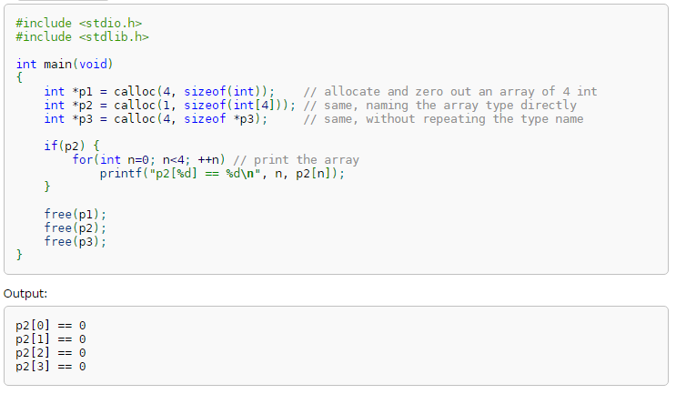

Slide 30
The realloc Function
The realloc function can resize a dynamically allocated array.
Prototype for realloc:
void *realloc(void *ptr, size_t size);
ptr must point to a memory block obtained by a previous call of malloc, calloc, or realloc.
size represents the new size of the block, which may be larger or smaller than the original size.

Slide 31
The realloc Function
Properties of realloc:
When it expands a memory block, realloc doesn’t initialize the bytes that are added to the block.
If realloc can’t enlarge the memory block as requested, it returns a null pointer; the data in the old memory block is unchanged.
If realloc is called with a null pointer as its first argument, it behaves like malloc.
If realloc is called with 0 as its second argument, it frees the memory block.

Slide 32
The realloc Function
We expect realloc to be reasonably efficient:
When asked to reduce the size of a memory block, realloc should shrink the block “in place.”
realloc should always attempt to expand a memory block without moving it.
If it can’t enlarge a block, realloc will allocate a new block elsewhere, then copy the contents of the old block into the new one.
Once realloc has returned, be sure to update all pointers to the memory block in case it has been moved.

Slide 33
Deallocating Storage
malloc and the other memory allocation functions obtain memory blocks from a storage pool known as the heap.
Calling these functions too often—or asking them for large blocks of memory—can exhaust the heap, causing the functions to return a null pointer.
To make matters worse, a program may allocate blocks of memory and then lose track of them, thereby wasting space.

Slide 34
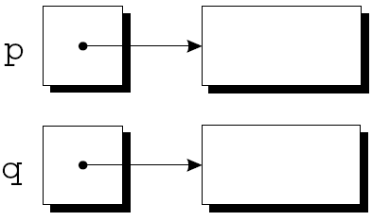
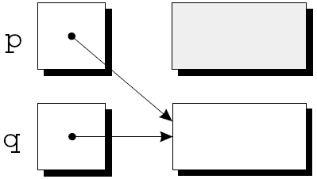
Deallocating Storage
Example:
p = malloc(…);
q = malloc(…);
p = q;
A snapshot after the first two statements have been executed:

Slide 35
Deallocating Storage
After q is assigned to p, both variables now point to the second memory block:
There are no pointers to the first block, so we’ll never be able to use it again.

Slide 36
Deallocating Storage
A block of memory that’s no longer accessible to a program is said to be garbage.
A program that leaves garbage behind has a memory leak.
Some languages provide a garbage collector that automatically locates and recycles garbage, but C doesn’t.
Instead, each C program is responsible for recycling its own garbage by calling the free function to release unneeded memory.

Slide 37
The free Function
Prototype for free:
void free(void *ptr);
free will be passed a pointer to an unneeded memory block:
p = malloc(…);
q = malloc(…);
free(p);
p = q;
Calling free releases the block of memory that p points to.

Slide 38
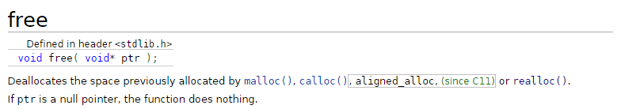
#include <stdlib.h>
int main(void)
{
int *p1 = malloc(10*sizeof *p1);
free(p1); // every allocated pointer must be freed
int *p2 = calloc(10, sizeof *p2);
int *p3 = realloc(p2, 1000*sizeof *p3);
if(p3) // p3 not null means p2 was freed by realloc
free(p3);
else // p3 null means p2 was not freed
free(p2);
}

Slide 39
The “Dangling Pointer” Problem
Using free leads to a new problem: dangling pointers.
free(p) deallocates the memory block that p points to, but doesn’t change p itself.
If we forget that p no longer points to a valid memory block, chaos may ensue:
char *p = malloc(4);
…
free(p);
…
strcpy(p, "abc"); /*** WRONG ***/
Modifying the memory that p points to is a serious error.

Slide 40
The “Dangling Pointer” Problem
Dangling pointers can be hard to spot, since several pointers may point to the same block of memory.
When the block is freed, all the pointers are left dangling.
https://mropengate.blogspot.com/2015/12/cc-dynamic-2d-arrays-in-c.html

Slide 41
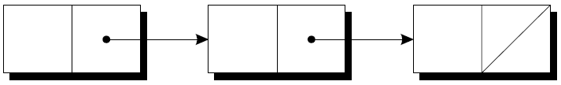
Linked Lists
Dynamic storage allocation is especially useful for building lists, trees, graphs, and other linked data structures.
A linked list consists of a chain of structures (called nodes), with each node containing a pointer to the next node in the chain:
The last node in the list contains a null pointer.

Slide 42
Linked Lists
A linked list is more flexible than an array: we can easily insert and delete nodes in a linked list, allowing the list to grow and shrink as needed.
On the other hand, we lose the “random access” capability of an array:
Any element of an array can be accessed in the same amount of time.
Accessing a node in a linked list is fast if the node is close to the beginning of the list, slow if it’s near the end.

Slide 43
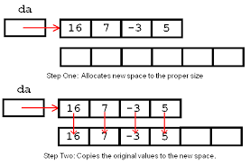
Linked Lists: avoid allocating and moving large data

Slide 44
Declaring a Node Type
To set up a linked list, we’ll need a structure that represents a single node.
A node structure will contain data (an integer in this example) plus a pointer to the next node in the list:
struct node {
int value; /* data stored in the node */
struct node *next; /* pointer to the next node */
};
node must be a tag, not a typedef name, or there would be no way to declare the type of next.

Slide 45
Declaring a Node Type
Next, we’ll need a variable that always points to the first node in the list:
struct node *first = NULL;
Setting first to NULL indicates that the list is initially empty.

Slide 46
Creating a Node
As we construct a linked list, we’ll create nodes one by one, adding each to the list.
Steps involved in creating a node:
Allocate memory for the node.
Store data in the node.
Insert the node into the list.
We’ll concentrate on the first two steps for now.

Slide 47
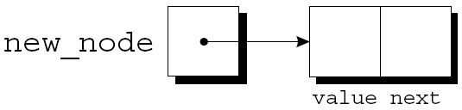
Creating a Node
When we create a node, we’ll need a variable that can point to the node temporarily:
struct node *newNode;
We’ll use malloc to allocate memory for the new node, saving the return value in newNode:
newNode = malloc(sizeof(struct node));
newNode now points to a block of memory just large enough to hold a node structure:

Slide 48
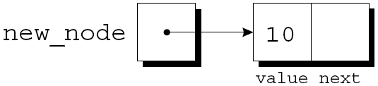
Creating a Node
Next, we’ll store data in the value member of the new node:
(*newNode).value = 10;
The resulting picture:
The parentheses around *newNode are mandatory because the . operator would otherwise take precedence over the * operator.

Slide 49
The -> Operator
Accessing a member of a structure using a pointer is so common that C provides a special operator for this purpose.
This operator, known as right arrow selection, is a minus sign followed by >.
Using the -> operator, we can write
newNode->value = 10;
instead of
(*newNode).value = 10;

Slide 50
The -> Operator
The -> operator produces an lvalue, so we can use it wherever an ordinary variable would be allowed.
A scanf example:
scanf("%d", &newNode->value);
The & operator is still required, even though newNode is a pointer.

Slide 51
Inserting a Node at the Beginning of a Linked List
One of the advantages of a linked list is that nodes can be added at any point in the list.
However, the beginning of a list is the easiest place to insert a node.
Suppose that newNode is pointing to the node to be inserted, and first is pointing to the first node in the linked list.

Slide 52
Inserting a Node at the Beginning of a Linked List
It takes two statements to insert the node into the list.
The first step is to modify the new node’s next member to point to the node that was previously at the beginning of the list:
newNode->next = first;
The second step is to make first point to the new node:
first = newNode;
These statements work even if the list is empty.

Slide 53
Inserting a Node at the Beginning of a Linked List
Let’s trace the process of inserting two nodes into an empty list.
We’ll insert a node containing the number 10 first, followed by a node containing 20.

Slide 54
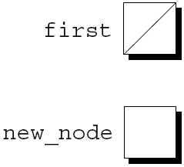
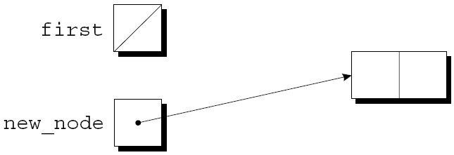
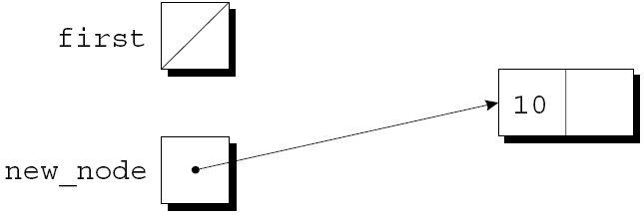
Inserting a Node at the Beginning of a Linked List
first = NULL;
newNode =
malloc(sizeof(struct node));
newNode->value = 10;

Slide 55
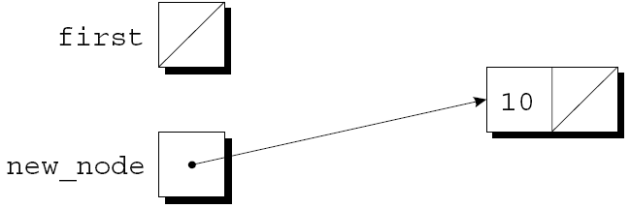
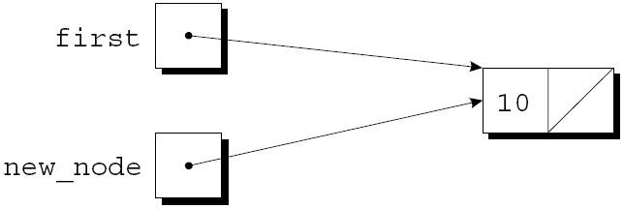
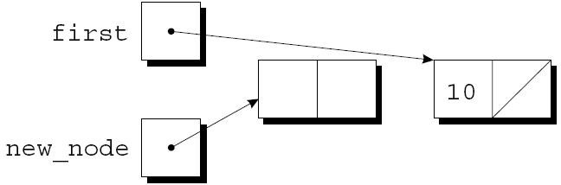
Inserting a Node at the Beginning of a Linked List
newNode->next = first;
first = newNode;
newNode =
malloc(sizeof(struct node));

Slide 56
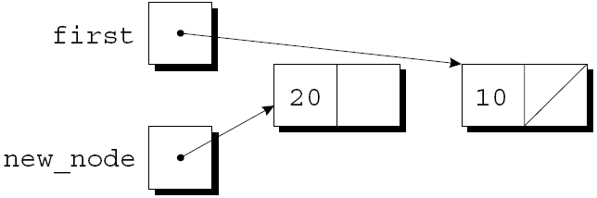
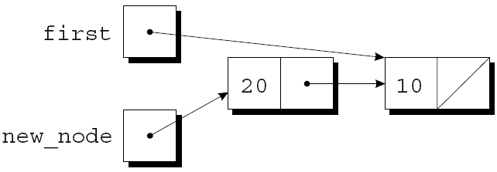
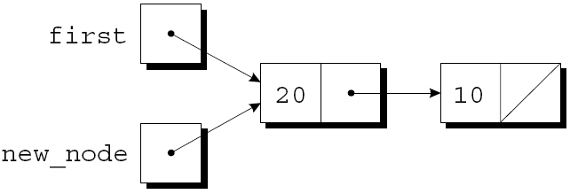
Inserting a Node at the Beginning of a Linked List
newNode->value = 20;
newNode->next = first;
first = newNode;

Slide 57
Inserting a Node at the Beginning of a Linked List
A function that inserts a node containing n into a linked list, which pointed to by list:
struct node *add2List(struct node *list, int n)
{
struct node *newNode;
newNode = malloc(sizeof(struct node));
if (newNode == NULL) {
printf("Error: malloc failed in add2List\n");
exit(EXIT_FAILURE);
}
newNode->value = n;
newNode->next = list;
return newNode;
}

Slide 58
Inserting a Node at the Beginning of a Linked List
Note that add2List returns a pointer to the newly created node (now at the beginning of the list).
When we call add2List, we’ll need to store its return value into first:
first = add2List(first, 10);
first = add2List(first, 20);
Getting add2List to update first directly, rather than return a new value for first, turns out to be tricky.

Slide 59
Inserting a Node at the Beginning of a Linked List
A function that uses add2List to create a linked list containing numbers entered by the user:
struct node *readNumbers(void)
{
struct node *first = NULL;
int n;
printf("Enter a series of integers (0 to terminate): ");
for (;;) {
scanf("%d", &n);
if (n == 0)
return first;
first = add2List(first, n);
}
}
The numbers will be in reverse order within the list.

Slide 60
Searching a Linked List
Although a while loop can be used to search a list, the for statement is often superior.
A loop that visits the nodes in a linked list, using a pointer variable p to keep track of the “current” node:
for (p = first; p != NULL; p = p->next)
…
A loop of this form can be used in a function that searches a list for an integer n.

Slide 61
Searching a Linked List
If it finds n, the function will return a pointer to the node containing n; otherwise, it will return a null pointer.
An initial version of the function:
struct node *searchList(struct node *list, int n)
{
struct node *p;
for (p = list; p != NULL; p = p->next)
if (p->value == n)
return p;
return NULL;
}

Slide 62
Searching a Linked List
There are many other ways to write searchList.
One alternative is to eliminate the p variable, instead using list itself to keep track of the current node:
struct node *searchList(struct node *list, int n)
{
for (; list != NULL; list = list->next)
if (list->value == n)
return list;
return NULL;
}
Since list is a copy of the original list pointer, there’s no harm in changing it within the function.

Slide 63
Searching a Linked List
Another alternative:
struct node *searchList(struct node *list, int n)
{
for (; list != NULL && list->value != n;
list = list->next)
;
return list;
}
Since list is NULL if we reach the end of the list, returning list is correct even if we don’t find n.

Slide 64
Searching a Linked List
This version of searchList might be a bit clearer if we used a while statement:
struct node *searchList(struct node *list, int n)
{
while (list != NULL && list->value != n)
list = list->next;
return list;
}

Slide 65
Deleting a Node from a Linked List
A big advantage of storing data in a linked list is that we can easily delete nodes.
Deleting a node involves three steps:
Locate the node to be deleted.
Alter the previous node so that it “bypasses” the deleted node.
Call free to reclaim the space occupied by the deleted node.
Step 1 is harder than it looks, because step 2 requires changing the previous node.
There are various solutions to this problem.

Slide 66
Deleting a Node from a Linked List
The “trailing pointer” technique involves keeping a pointer to the previous node (prev) as well as a pointer to the current node (cur).
Assume that list points to the list to be searched and n is the integer to be deleted.
A loop that implements step 1:
for (cur = list, prev = NULL;
cur != NULL && cur->value != n;
prev = cur, cur = cur->next)
;
When the loop terminates, cur points to the node to be deleted and prev points to the previous node.

Slide 67
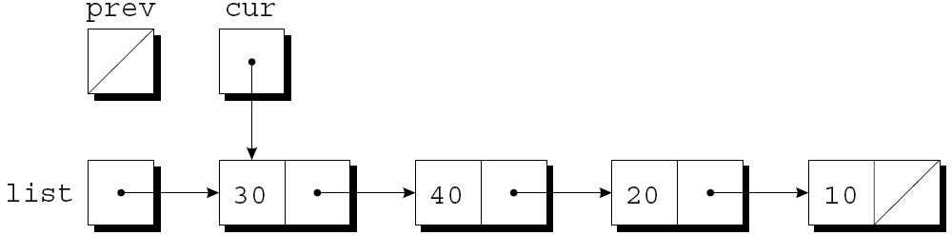
Deleting a Node from a Linked List
Assume that list has the following appearance and n is 20:
After cur = list, prev = NULL has been executed:

Slide 68
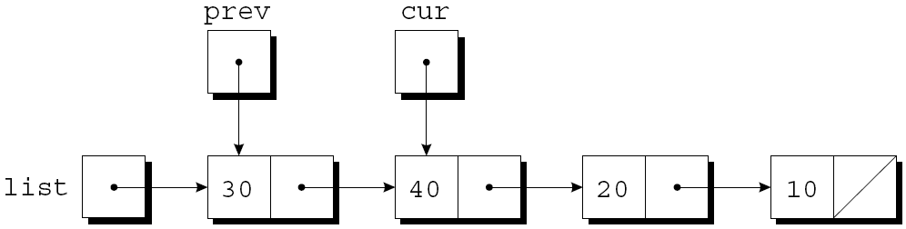
Deleting a Node from a Linked List
The test cur != NULL && cur->value != n is true, since cur is pointing to a node and the node doesn’t contain 20.
After prev = cur, cur = cur->next has been executed:

Slide 69
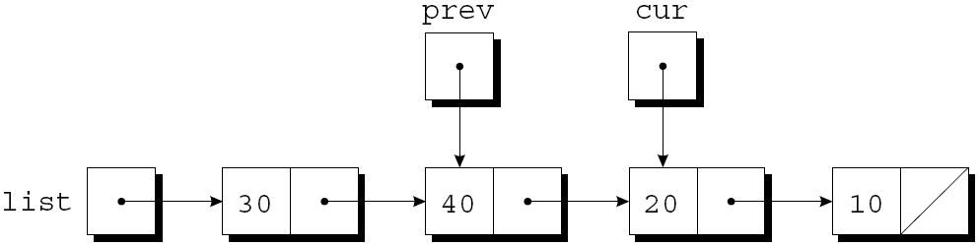
Deleting a Node from a Linked List
The test cur != NULL && cur->value != n is again true, so prev = cur, cur = cur->next is executed once more:
Since cur now points to the node containing 20, the condition cur->value != n is false and the loop terminates.

Slide 70
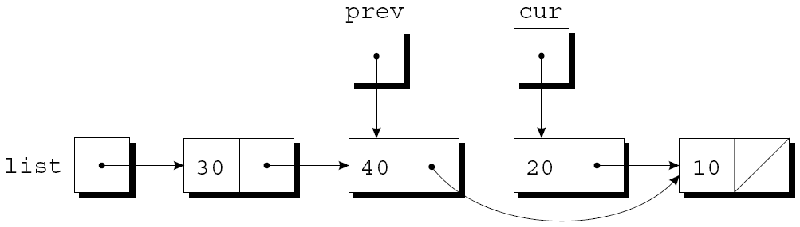
Deleting a Node from a Linked List
Next, we’ll perform the bypass required by step 2.
The statement
prev->next = cur->next;
makes the pointer in the previous node point to the node after the current node:

Slide 71
Deleting a Node from a Linked List
Step 3 is to release the memory occupied by the current node:
free(cur);

Slide 72
Deleting a Node from a Linked List
The deleteFromList function uses the strategy just outlined.
When given a list and an integer n, the function deletes the first node containing n.
If no node contains n, deleteFromList does nothing.
In either case, the function returns a pointer to the list.
Deleting the first node in the list is a special case that requires a different bypass step.

Slide 73
Deleting a Node from a Linked List
struct node *deleteFromList(struct node *list, int n)
{
struct node *cur, *prev;
for (cur = list, prev = NULL;
cur != NULL && cur->value != n;
prev = cur, cur = cur->next)
;
if (cur== NULL)return list;/*n was not found */
if (prev== NULL)list= list->next; /* n is in the first node */
else
prev->next = cur->next;/*n is in some other node */
free(cur);
return list;
}

Slide 74
Ordered Lists
When the nodes of a list are kept in order—sorted by the data stored inside the nodes—we say that the list is ordered.
Inserting a node into an ordered list is more difficult, because the node won’t always be put at the beginning of the list.
However, searching is faster: we can stop looking after reaching the point at which the desired node would have been located.

Slide 75
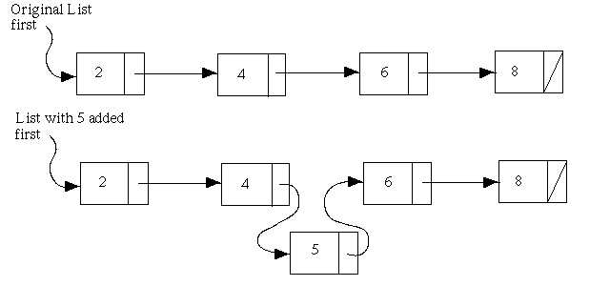

Slide 76
Program: Maintaining a Parts Database (Revisited)
The inventory2.c program is a modification of the parts database program of Chapter 16, with the database stored in a linked list this time.
Advantages of using a linked list:
No need to put a limit on the size of the database.
Database can easily be kept sorted by part number.
In the original program, the database wasn’t sorted.

Slide 77
Program: Maintaining a Parts Database (Revisited)
The part structure will contain an additional member (a pointer to the next node):
struct part {
int number;
char name[NAME_LEN+1];
int onHand;
struct part *next;
};
inventory will point to the first node in the list:
struct part *inventory = NULL;

Slide 78
Program: Maintaining a Parts Database (Revisited)
Most of the functions in the new program will closely resemble their counterparts in the original program.
findPart and insert will be more complex, however, since we’ll keep the nodes in the inventory list sorted by part number.

Slide 79
Program: Maintaining a Parts Database (Revisited)
In the original program, findPart returns an index into the inventory array.
In the new program, findPart will return a pointer to the node that contains the desired part number.
If it doesn’t find the part number, findPart will return a null pointer.

Slide 80
Program: Maintaining a Parts Database (Revisited)
Since the list of parts is sorted, findPart can stop when it finds a node containing a part number that’s greater than or equal to the desired part number.
findPart’s search loop:
for (p = inventory;
p != NULL && number > p->number;
p = p->next)
;
When the loop terminates, we’ll need to test whether the part was found:
if (p != NULL && number == p->number)
return p;

Slide 81
Program: Maintaining a Parts Database (Revisited)
The original version of insert stores a new part in the next available array element.
The new version must determine where the new part belongs in the list and insert it there.
It will also check whether the part number is already present in the list.
A loop that accomplishes both tasks:
for (cur = inventory, prev = NULL;
cur != NULL && newNode->number > cur->number;
prev = cur, cur = cur->next)
;

Slide 82
Program: Maintaining a Parts Database (Revisited)
Once the loop terminates, insert will check whether cur isn’t NULL and whether newNode->number equals cur->number.
If both are true, the part number is already in the list.
Otherwise, insert will insert a new node between the nodes pointed to by prev and cur.
This strategy works even if the new part number is larger than any in the list.
Like the original program, this version requires the readLine function of Chapter 16.

Slide 83
/* Maintains a parts database(linked list version) */
#include <stdio.h>
#include <stdlib.h>
#include "readline.h"
#define NAME_LEN 25
struct part {
int number;
char name[NAME_LEN+1];
int onHand;
struct part *next;
};
struct part *inventory = NULL; /*pts to 1st part */
struct part *findPart(int number);
void insert(void);
void search(void);
void update(void);
void print(void);
inventory2.c

Slide 84
int main(void)
{
char code;
for (;;) {
printf("Enter operation code: ");
scanf(" %c", &code);
while (getchar() != '\n')/*skips to end of line */
;
switch (code)
{
case 'i': insert(); break;
case 's': search(); break;
case 'u': update(); break;
case 'p': print(); break;
case 'q': return 0;
default: printf("Illegal code\n");
}
printf("\n");
}
}

Slide 85
struct part *findPart(int number)
{
struct part *p;
for(p = inventory;
p != NULL && number > p->number;
p = p->next)
;
if (p!= NULL && number== p->number)
return p;
return NULL;
}

Slide 86
void insert(void)
{
struct part *cur, *prev, *newNode;
newNode = malloc(sizeof(struct part));
if (newNode == NULL) {
printf("Database is full; can't add more parts.\n");
return;
}
printf("Enter part number: ");
scanf("%d", &newNode->number);
for (cur= inventory, prev= NULL;
cur!=NULL&& newNode->number> cur->number;
prev = cur, cur = cur->next)
;

Slide 87
if (cur!=NULL && newNode->number==cur->number)
{
printf("Part already exists.\n");
free(newNode);
return;
}
printf("Enter part name: ");
readLine(newNode->name, NAME_LEN);
printf("Enter quantity on hand: ");
scanf("%d", &newNode->onHand);
newNode->next = cur;
if (prev == NULL) inventory = newNode;
else prev->next = newNode;
}// void insert(void)

Slide 88
void search(void)
{
int number;
struct part *p;
printf("Enter part number: ");
scanf("%d", &number);
p = findPart(number);
if (p != NULL) {
printf("Part name: %s\n", p->name);
printf("Quantity on hand: %d\n", p->onHand);
} else
printf("Part not found.\n");
}

Slide 89
/**********************************************************
* update: Prompts the user to enter a part number. *
* Prints an error message if the part doesn't *
* exist; otherwise, prompts the user to enter *
* change in quantity on hand and updates the *
* database. *
**********************************************************/
void update(void)
{
int number, change;
struct part *p;
printf("Enter part number: ");
scanf("%d", &number);
p = findPart(number);
if (p != NULL) {
printf("Enter change in quantity on hand: ");
scanf("%d", &change);
p->onHand += change;
} else
printf("Part not found.\n");
}

Slide 90
/**********************************************************
* print: Prints a listing of all parts in the database, *
* showing the part number, part name, and *
* quantity on hand. Part numbers will appear in *
* ascending order. *
**********************************************************/
void print(void)
{
struct part *p;
printf("Part Number Part Name "
"Quantity on Hand\n");
for (p = inventory; p != NULL; p = p->next)
printf("%7d %-25s%11d\n", p->number, p->name, p->onHand);
}

Slide 91
Pointers to Pointers
Chapter 13 introduced the idea of a pointer to a pointer.
The concept of “pointers to pointers” also pops up frequently in the context of linked data structures.
In particular, when an argument to a function is a pointer variable, we may want the function to be able to modify the variable.
Doing so requires the use of a pointer to a pointer.

Slide 92
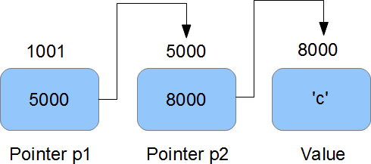
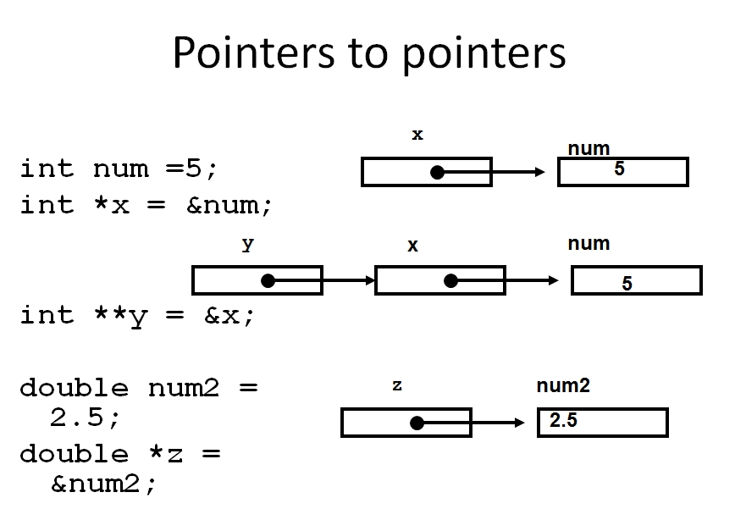

Slide 93
Pointers to Pointers
#include <stdio.h>
int main ()
{
int var
int *ptr;
int **pptr;
var = 3000;
ptr = &var; /* take the address of var */
/* take the address of ptr using address of operator & */
pptr = &ptr;
/* take the value using pptr */
printf("Value of var = %d\n", var );
printf("Value available at *ptr = %d\n", *ptr );
printf("Value available at **pptr = %d\n", **pptr);
return 0;
}
Value of var = 3000
Value available at *ptr = 3000
Value available at **pptr = 3000

Slide 94
Pointers to Pointers
The add2List function is passed a pointer to the first node in a list; it returns a pointer to the first node in the updated list:
struct node *add2List(struct node *list, int n)
{
struct node *newNode;
newNode = malloc(sizeof(struct node));
if (newNode == NULL) {
printf("Error: malloc failed in add2List\n");
exit(EXIT_FAILURE);
}
newNode->value = n;
newNode->next = list;
return newNode;
}

Slide 95
void add2List(struct node *list, int n)
{
struct node *newNode;
newNode = malloc(sizeof(struct node));
if (newNode == NULL) {
printf("Error: malloc failed in add2List\n");
exit(EXIT_FAILURE);
}
newNode->value = n;
newNode->next = list;
list= newNode;
}
Modifying add2List so that it assigns newNode to list instead of returning newNode

Slide 96
Pointers to Pointers
Modifying add2List so that it assigns newNode to list instead of returning newNode
doesn’t work.
Example:
add2List(first, 10);
At the point of the call, first is copied into list.
If the function changes the value of list, making it point to the new node, first is not affected.

Slide 97
Pointers to Pointers
Getting add2List to modify first requires passing add2List a pointer to first:
void add2List(struct node **list, int n)
{
struct node *newNode;
newNode = malloc(sizeof(struct node));
if (newNode == NULL) {
printf("Error: malloc failed in add2List\n");
exit(EXIT_FAILURE);
}
newNode->value = n;
newNode->next = *list;
*list = newNode;
}

Slide 98
Pointers to Pointers
When the new version of add2List is called, the first argument will be the address of first:
add2List(&first, 10);
Since list is assigned the address of first, we can use *list as an alias for first.
In particular, assigning newNode to *list will modify first.

Slide 99
Pointers to Functions
C doesn’t require that pointers point only to data; it’s also possible to have pointers to functions.
Functions occupy memory locations, so every function has an address.
We can use function pointers in much the same way we use pointers to data.
Passing a function pointer as an argument is fairly common.

Slide 100
#include <stdio.h>
void myIntFunc(int x) { printf( “%d\n”, x ); }
int main()
{
void (*foo)(int);
foo = &myIntFunc;
/* call myIntFunc (u do not need to write (*foo)(2) ) */
foo( 2 );
/* but if you want to, you may */
(*foo)( 2 );
return 0;
}

Slide 101
Function Pointers as Arguments
A function named integrate that integrates a mathematical function f can be made as general as possible by passing f as an argument.
Prototype for integrate :
double integrate(double (*f)(double),
double a, double b);
The parentheses around *f indicate that f is a pointer to a function.
An alternative prototype:
double integrate(double f(double),
double a, double b);

Slide 102
Function Pointers as Arguments
A call of integrate that integrates the sin (sine) function from 0 to π/2:
result = integrate(sin, 0.0, PI / 2);
When a function name isn’t followed by parentheses, the C compiler produces a pointer to the function.
Within the body of integrate, we can call the function that f points to:
y = (*f)(x);
Writing f(x) instead of (*f)(x) is allowed.

Slide 103
The qsort Function
Some of the most useful functions in the C library require a function pointer as an argument.
One of these is qsort, which belongs to the <stdlib.h> header.
qsort is a general-purpose sorting function that’s capable of sorting any array.

Slide 104
The qsort Function
qsort must be told how to determine which of two array elements is “smaller.”
This is done by passing qsort a pointer to a comparison function.
When given two pointers p and q to array elements, the comparison function must return an integer that is:
Negative if *p is “less than” *q
Zero if *p is “equal to” *q
Positive if *p is “greater than” *q

Slide 105
The qsort Function
Prototype for qsort:
void qsort(void *base, size_t nmemb, size_t size,
int (*compar)(const void *, const void *));
base must point to the first element in the array (or the first element in the portion to be sorted).
nmemb is the number of elements to be sorted.
size is the size of each array element, measured in bytes.
compar is a pointer to the comparison function.

Slide 106
The qsort Function
When qsort is called, it sorts the array into ascending order, calling the comparison function whenever it needs to compare array elements.
A call of qsort that sorts the inventory array of Chapter 16:
qsort(inventory, num_parts,
sizeof(struct part), compareParts);
compareParts is a function that compares two part structures.

Slide 107
The qsort Function
Writing the compareParts function is tricky.
qsort requires that its parameters have type void *, but we can’t access the members of a part structure through a void * pointer.
To solve the problem, compareParts will assign its parameters, p and q, to variables of type struct part *.

Slide 108
The qsort Function
A version of compareParts that can be used to sort the inventory array into ascending order by part number:
int compareParts(const void *p, const void *q)
{
const struct part *p1 = p;
const struct part *q1 = q;
if (p1->number < q1->number)
return -1;
else if (p1->number == q1->number)
return 0;
else
return 1;
}

Slide 109
The qsort Function
Most C programmers would write the function more concisely:
int compareParts(const void *p, const void *q)
{
if (((struct part *) p)->number <
((struct part *) q)->number)
return -1;
else if (((struct part *) p)->number ==
((struct part *) q)->number)
return 0;
else
return 1;
}

Slide 110
The qsort Function
compare_parts can be made even shorter by removing the if statements:
int compareParts(const void *p, const void *q)
{
return ((struct part *) p)->number -
((struct part *) q)->number;
}

Slide 111
The qsort Function
A version of compareParts that can be used to sort the inventory array by part name instead of part number:
int compareParts(const void *p, const void *q)
{
return strcmp(((struct part *) p)->name,
((struct part *) q)->name);
}

Slide 112
Other Uses of Function Pointers
Although function pointers are often used as arguments, that’s not all they’re good for.
C treats pointers to functions just like pointers to data.
They can be stored in variables or used as elements of an array or as members of a structure or union.
It’s even possible for functions to return function pointers.

Slide 113
Other Uses of Function Pointers
A variable that can store a pointer to a function with an int parameter and a return type of void:
void (*pf)(int);
If f is such a function, we can make pf point to f in the following way:
pf = f;
We can now call f by writing either
(*pf)(i);
or
pf(i);

Slide 114
Other Uses of Function Pointers
An array whose elements are function pointers:
void (*fileCmd[])(void) = {new_cmd,
open_cmd,
close_cmd,
close_all_cmd,
save_cmd,
save_as_cmd,
save_all_cmd,
print_cmd,
exit_cmd
};
A call of the function stored in position n of the file_cmd array:
(*fileCmd[n])();

Slide 115
Other Uses of Function Pointers
A call of the function stored in position n of the fileCmd array:
(*fileCmd[n])(); /* or fileCmd[n](); */
We could get a similar effect with a switch statement, but using an array of function pointers provides more flexibility.

Slide 116
Program: Tabulating the Trigonometric Functions
The tabulate.c program prints tables showing the values of the cos, sin, and tan functions.
The program is built around a function named tabulate that, when passed a function pointer f, prints a table showing the values of f.
tabulate uses the ceil function.
When given an argument x of double type, ceil returns the smallest integer that’s greater than or equal to x.

Slide 117
Program: Tabulating the Trigonometric Functions
A session with tabulate.c:
Enter initial value: 0
Enter final value: .5
Enter increment: .1
x cos(x)
------- -------
0.00000 1.00000
0.10000 0.99500
0.20000 0.98007
0.30000 0.95534
0.40000 0.92106
0.50000 0.87758

Slide 118
Program: Tabulating the Trigonometric Functions
x sin(x)
------- -------
0.00000 0.00000
0.10000 0.09983
0.20000 0.19867
0.30000 0.29552
0.40000 0.38942
0.50000 0.47943
x tan(x)
------- -------
0.00000 0.00000
0.10000 0.10033
0.20000 0.20271
0.30000 0.30934
0.40000 0.42279
0.50000 0.54630

Slide 119
/* Tabulates values of trigonometric functions */
#include <math.h>
#include <stdio.h>
void tabulate(double (*f)(double), double first,
double last, double incr);
int main(void){
double final, increment, initial;
printf("Enter initial value: ");
scanf("%lf", &initial);
printf("Enter final value: ");
scanf("%lf", &final);
printf("Enter increment: ");
scanf("%lf", &increment);
printf("\n x cos(x)"
"\n ------- -------\n");
tabulate(cos, initial, final, increment);
printf("\n x sin(x)"
"\n ------- -------\n");
tabulate(sin, initial, final, increment);
printf("\n x tan(x)"
"\n ------- -------\n");
tabulate(tan, initial, final, increment);
return 0;
}
tabulate.c

Slide 120
void tabulate(double (*f)(double), double first, double last, double incr)
{
double x;
int i, numIntervals;
numIntervals= ceil((last - first) / incr);
for (i = 0; i <= numIntervals; i++)
{
x = first + i * incr;
printf("%10.5f %10.5f\n", x, (*f)(x));
}
}

Slide 121
Function Pointer Examples
int addInt(int n, int m) {
return n+m;
}
int (*functionPtr)(int,int);
functionPtr = &addInt;
using function pointer
int sum = (*functionPtr)(2, 3); // sum == 5
Passing the pointer to another function is basically the same:
int add2to3(int (*functionPtr)(int, int)) {
return (*functionPtr)(2, 3);
}

Slide 122
use function pointers in return values
// function functionFactory which receives parameter n and returns a pointer to // another function which receives two ints and it returns another int
int (*functionFactory(int n))(int, int)
{
printf("Got parameter %d", n);
int (*functionPtr)(int,int) = &addInt;
return functionPtr;
}
use a typedef:
typedef int (*myFuncDef)(int, int);
// note that the typedef name is indeed myFuncDef
myFuncDef functionFactory(int n) {
printf("Got parameter %d", n);
myFuncDef functionPtr = &addInt;
return functionPtr;
}
int addInt(int n, int m) {
return n+m;
}

Slide 123
Function Pointer Examples
#include <stdio.h>
#include <stdlib.h>
#include <errno.h>
#include <string.h>
/** Our old friend die from ex17. */
void die(const char *message)
{
if(errno) { perror(message); }
else { printf("ERROR: %s\n", message); }
exit(1);
}

Slide 124
// a typedef creates a fake type, in this case for a function pointer
typedef int (*compare_cb)(int a, int b);
//** A classic bubble sort function that uses the compare_cb to do the sorting.
int *bubble_sort(int *numbers, int count, compare_cb cmp)
{
int temp = 0, i = 0, j = 0;
int *target = malloc(count * sizeof(int));
if(!target) die("Memory error.");
memcpy(target, numbers, count * sizeof(int));
for(i = 0; i < count; i++) {
for(j = 0; j < count - 1; j++) {
if(cmp(target[j], target[j+1]) > 0) {
temp = target[j+1];
target[j+1] = target[j];
target[j] = temp;
}
}
}
return target;
}

Slide 125
int main(int argc, char *argv[])
{
if(argc < 2) die("USAGE: ex18 4 3 1 5 6");
int count = argc - 1;
int i = 0;
char **inputs = argv + 1;
int *numbers = malloc(count * sizeof(int));
if(!numbers) die("Memory error.");
for(i = 0; i < count; i++) {
numbers[i] = atoi(inputs[i]);
}
test_sorting(numbers, count, sorted_order);
test_sorting(numbers, count, reverse_order);
test_sorting(numbers, count, strange_order);
free(numbers);
return 0;
}
int sorted_order(int a, int b)
{
return a - b;
}
int reverse_order(int a, int b)
{
return b - a;
}
int strange_order(int a, int b)
{
if(a == 0 || b == 0) {
return 0;
} else {
return a % b;
}
}

Slide 126
void test_sorting(int *numbers, int count, compare_cb cmp)
{
int i = 0;
int *sorted = bubble_sort(numbers, count, cmp);
if(!sorted) die("Failed to sort as requested.");
for(i = 0; i < count; i++) {
printf("%d ", sorted[i]);
}
printf("\n");
free(sorted);
}
typedef int (*compare_cb)(int a, int b);

Slide 127
Inspiration:
unsigned char *data = (unsigned char *)cmp;
for(i = 0; i < 25; i++) {
printf("%02x:", data[i]);
}
printf("\n")
the raw assembler byte code of the function itself:
55:48:89:e5:89:7d:fc:89:75:f8:8b:55:fc:8b:45:f8:29:d0:c9:c3:55:48:89:e5:89:

Slide 128
Restricted Pointers (C99)
In C99, the keyword restrict may appear in the declaration of a pointer:
int * restrict p;
p is said to be a restricted pointer.
The intent is that if p points to an object that is later modified, then that object is not accessed in any way other than through p.
Having more than one way to access an object is often called aliasing.

Slide 129
Restricted Pointers (C99)
Consider the following code:
int * restrict p;
int * restrict q;
p = malloc(sizeof(int));
Normally it would be legal to copy p into q and then modify the integer through q:
q = p;
*q = 0; /* causes undefined behavior */
Because p is a restricted pointer, the effect of executing the statement *q = 0; is undefined.

Slide 130
Restricted Pointers (C99)
To illustrate the use of restrict, consider the memcpy and memmove functions.
The C99 prototype for memcpy, which copies bytes from one object (pointed to by s2) to another (pointed to by s1):
void *memcpy(void * restrict s1,
const void * restrict s2,
size_t n);
The use of restrict with both s1 and s2 indicates that the objects to which they point shouldn’t overlap.

Slide 131
Restricted Pointers (C99)
In contrast, restrict doesn’t appear in the prototype for memmove:
void *memmove(void *s1, const void *s2,
size_t n);
memmove is similar to memcpy, but is guaranteed to work even if the source and destination overlap.
Example of using memmove to shift the elements of an array:
int a[100];
…
memmove(&a[0], &a[1], 99 * sizeof(int));

Slide 132
Restricted Pointers (C99)
Prior to C99, there was no way to document the difference between memcpy and memmove.
The prototypes for the two functions were nearly identical:
void *memcpy(void *s1, const void *s2,
size_t n);
void *memmove(void *s1, const void *s2,
size_t n);
The use of restrict in the C99 version of memcpy’s prototype is a warning that the s1 and s2 objects should not overlap.

Slide 133
Restricted Pointers (C99)
restrict provides information to the compiler that may enable it to produce more efficient code—a process known as optimization.
The C99 standard guarantees that restrict has no effect on the behavior of a program that conforms to the standard.
Most programmers won’t use restrict unless they’re fine-tuning a program to achieve the best possible performance.

Slide 134
Flexible Array Members (C99)
Occasionally, we’ll need to define a structure that contains an array of an unknown size.
For example, we might want a structure that stores the characters in a string together with the string’s length:
struct vstring {
int len;
char chars[N];
};
Using a fixed-length array is undesirable: it limits the length of the string and wastes memory.

Slide 135
Flexible Array Members (C99)
C programmers traditionally solve this problem by declaring the length of chars to be 1 and then dynamically allocating each string:
struct vstring {
int len;
char chars[1];
};
…
struct vstring *str =
malloc(sizeof(struct vstring) + n - 1);
str->len = n;
This technique is known as the “struct hack.”

Slide 136
Flexible Array Members (C99)
The struct hack is supported by many compilers.
Some (including GCC) even allow the chars array to have zero length.
The C89 standard doesn’t guarantee that the struct hack will work, but a C99 feature known as the flexible array member serves the same purpose.

Slide 137
Flexible Array Members (C99)
When the last member of a structure is an array, its length may be omitted:
struct vstring {
int len;
char chars[]; /* flexible array member - C99 only */
};
The length of the array isn’t determined until memory is allocated for a vstring structure:
struct vstring *str =
malloc(sizeof(struct vstring) + n);
str->len = n;
sizeof ignores the chars member when computing the size of the structure.

Slide 138
Flexible Array Members (C99)
Special rules for structures that contain a flexible array member:
The flexible array must be the last member.
The structure must have at least one other member.
Copying a structure that contains a flexible array member will copy the other members but not the flexible array itself.

Slide 139
Flexible Array Members (C99)
A structure that contains a flexible array member is an incomplete type.
An incomplete type is missing part of the information needed to determine how much memory it requires.
Incomplete types are subject to various restrictions.
In particular, an incomplete type can’t be a member of another structure or an element of an array.
However, an array may contain pointers to structures that have a flexible array member.

